Slide 1
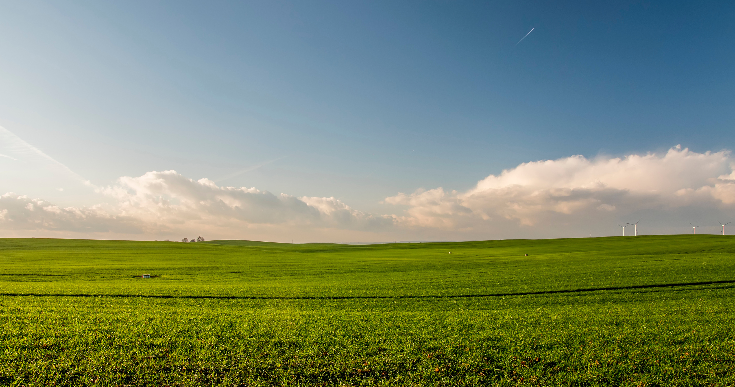

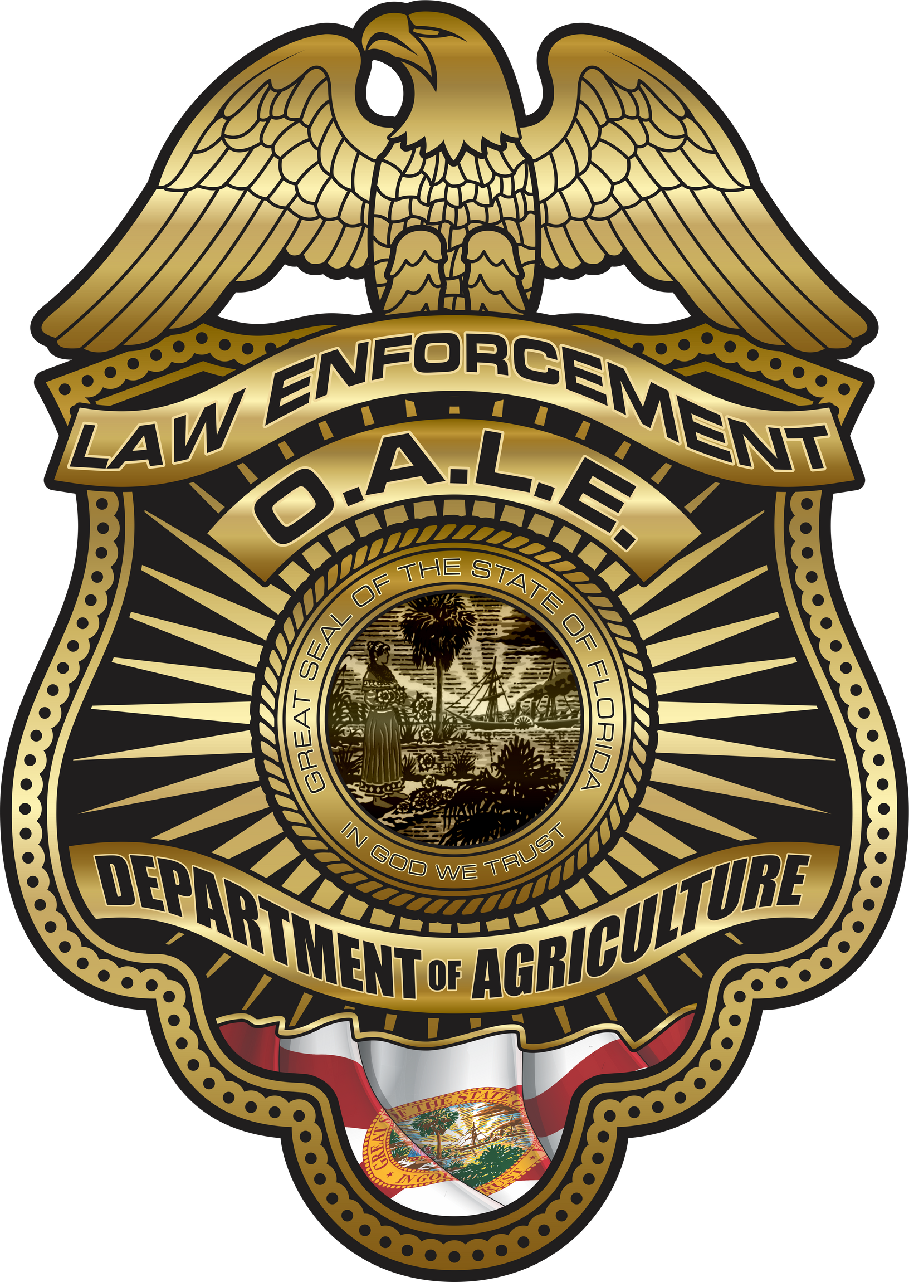
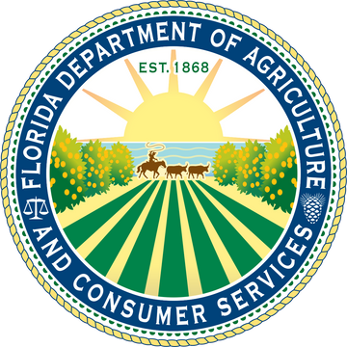
AGRICULTURE PROTECTION AND SECURITY IN THE STATE OF FLORIDA
OFFICE OF AGRICULTURAL LAW ENFORCEMENT
presented by:
COLONEL LEE ADAMS

Slide 2
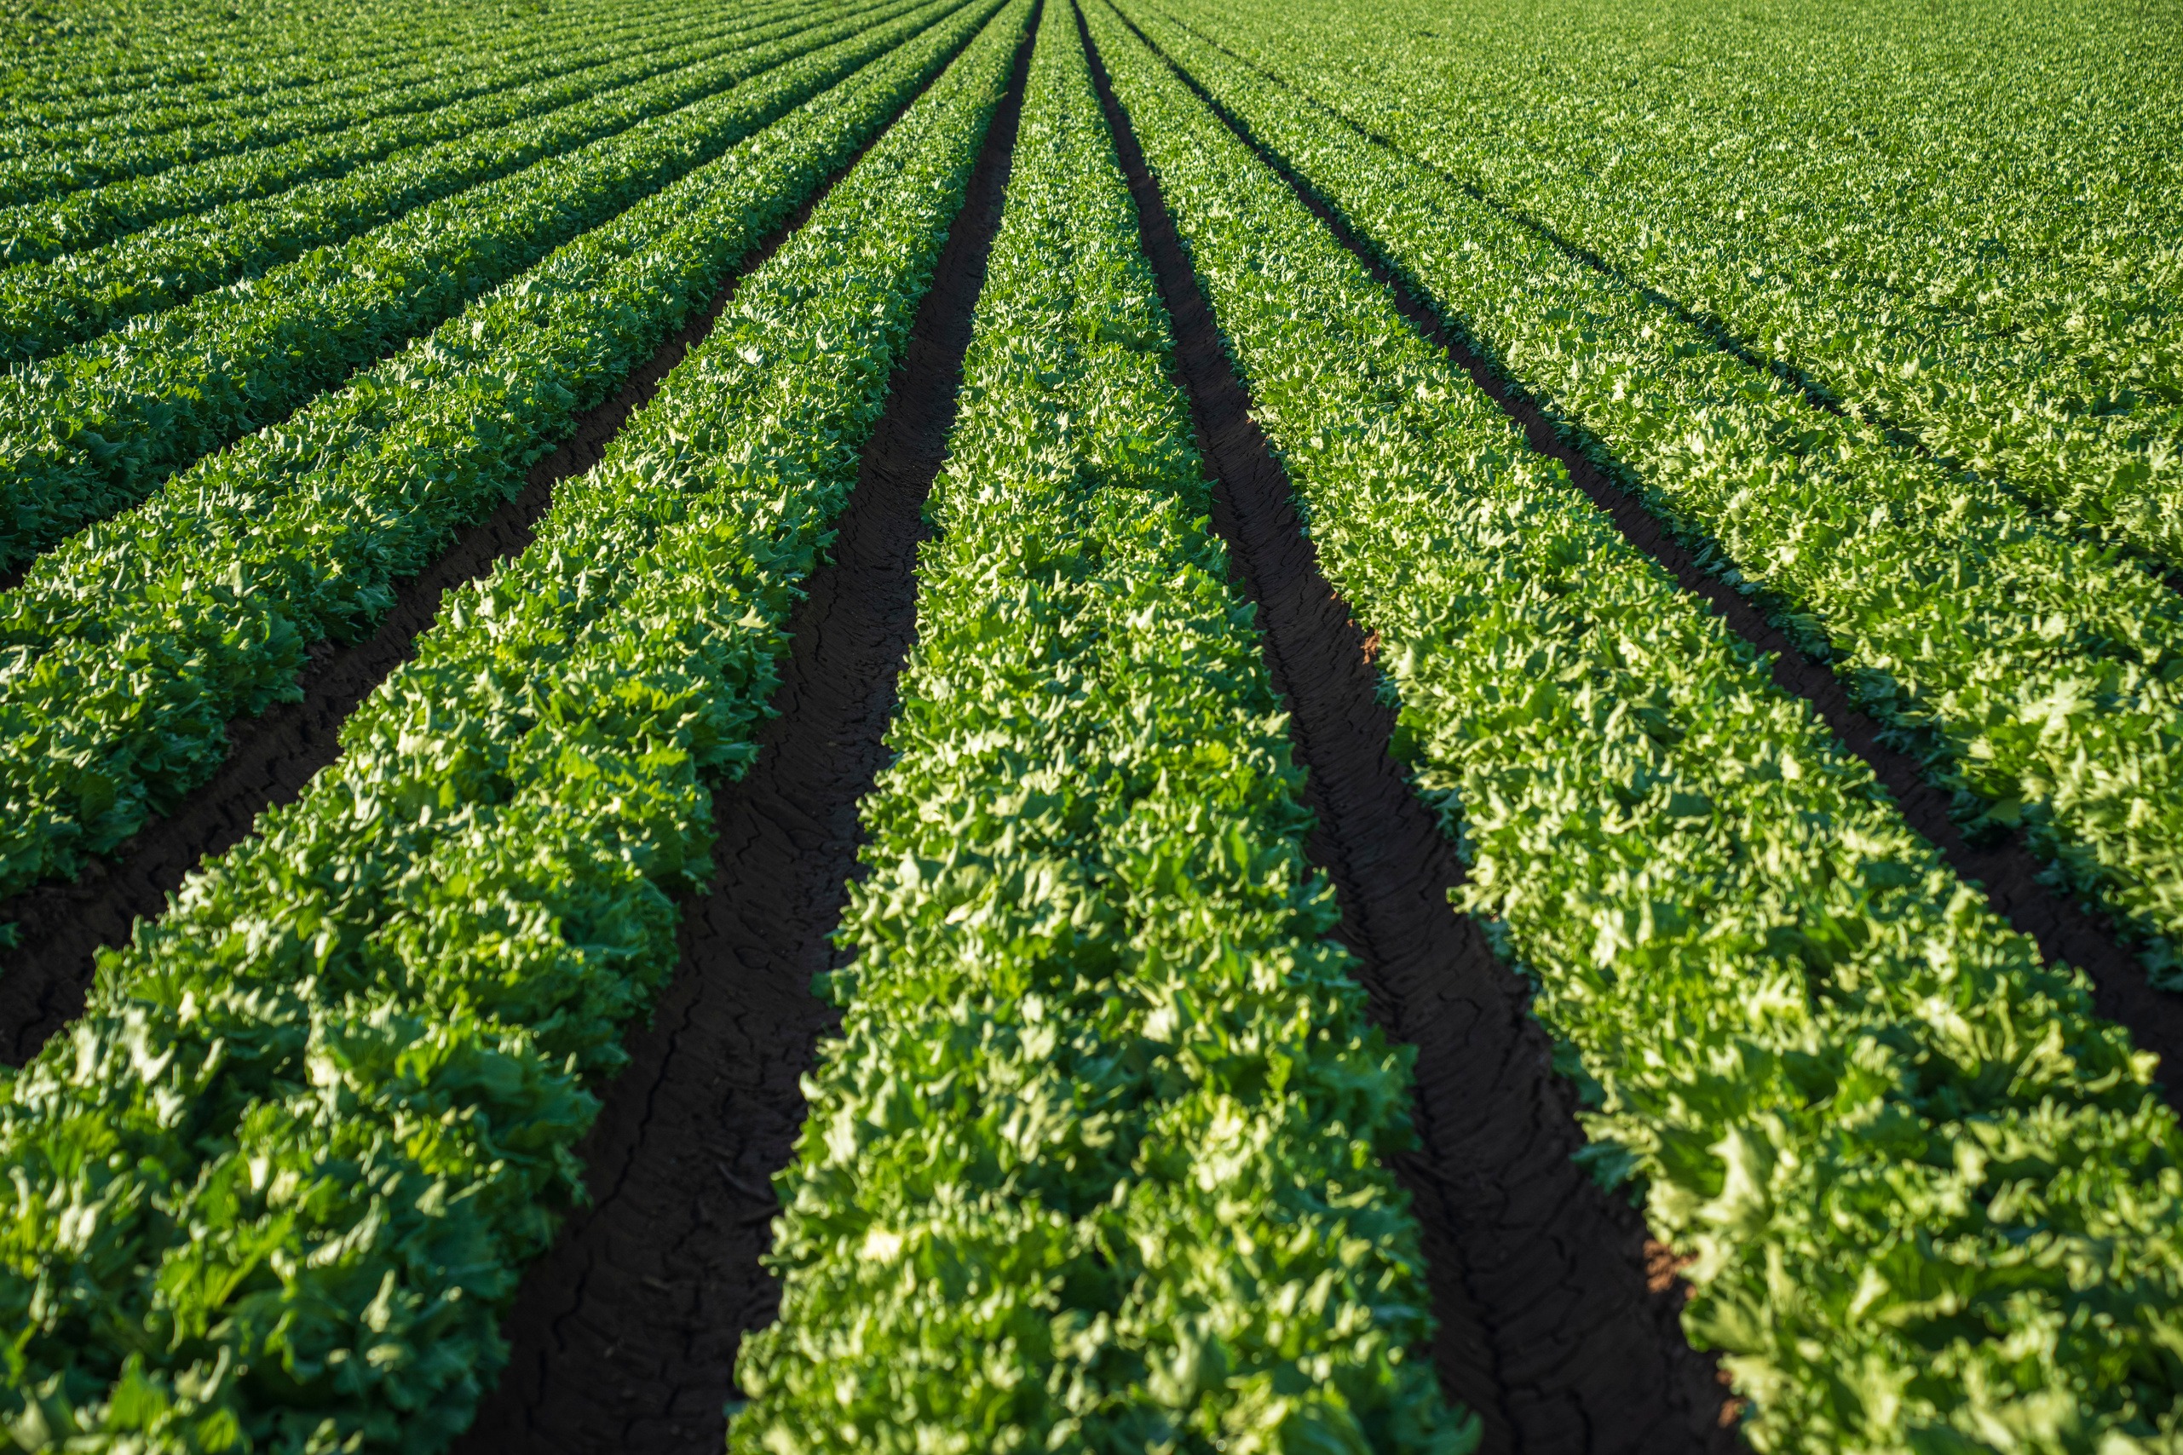

OALE Overview
FDACS Divisions
Division of Administration
Division of Agricultural Environmental Services
Division of Animal Industry
Division of Aquaculture
Division of Consumer Services
Division of Food, Nutrition, and Wellness
Division of Food Safety
Division of Fruit & Vegetables
Division of Licensing
Division of Marketing & Development
Division of Plant Industry
Florida Forest Service
Office of Agricultural Water Policy
Office of Energy
Office of Agricultural Law Enforcement (OALE)
Investigative Services (BIS)
Uniform Services (BUS)
Director’s Office
Administration
Special Operations

Slide 3
The Office of Agricultural Law Enforcement
is dedicated to protecting
Florida’s agriculture
and its consumers
through professional
law enforcement.

Slide 4
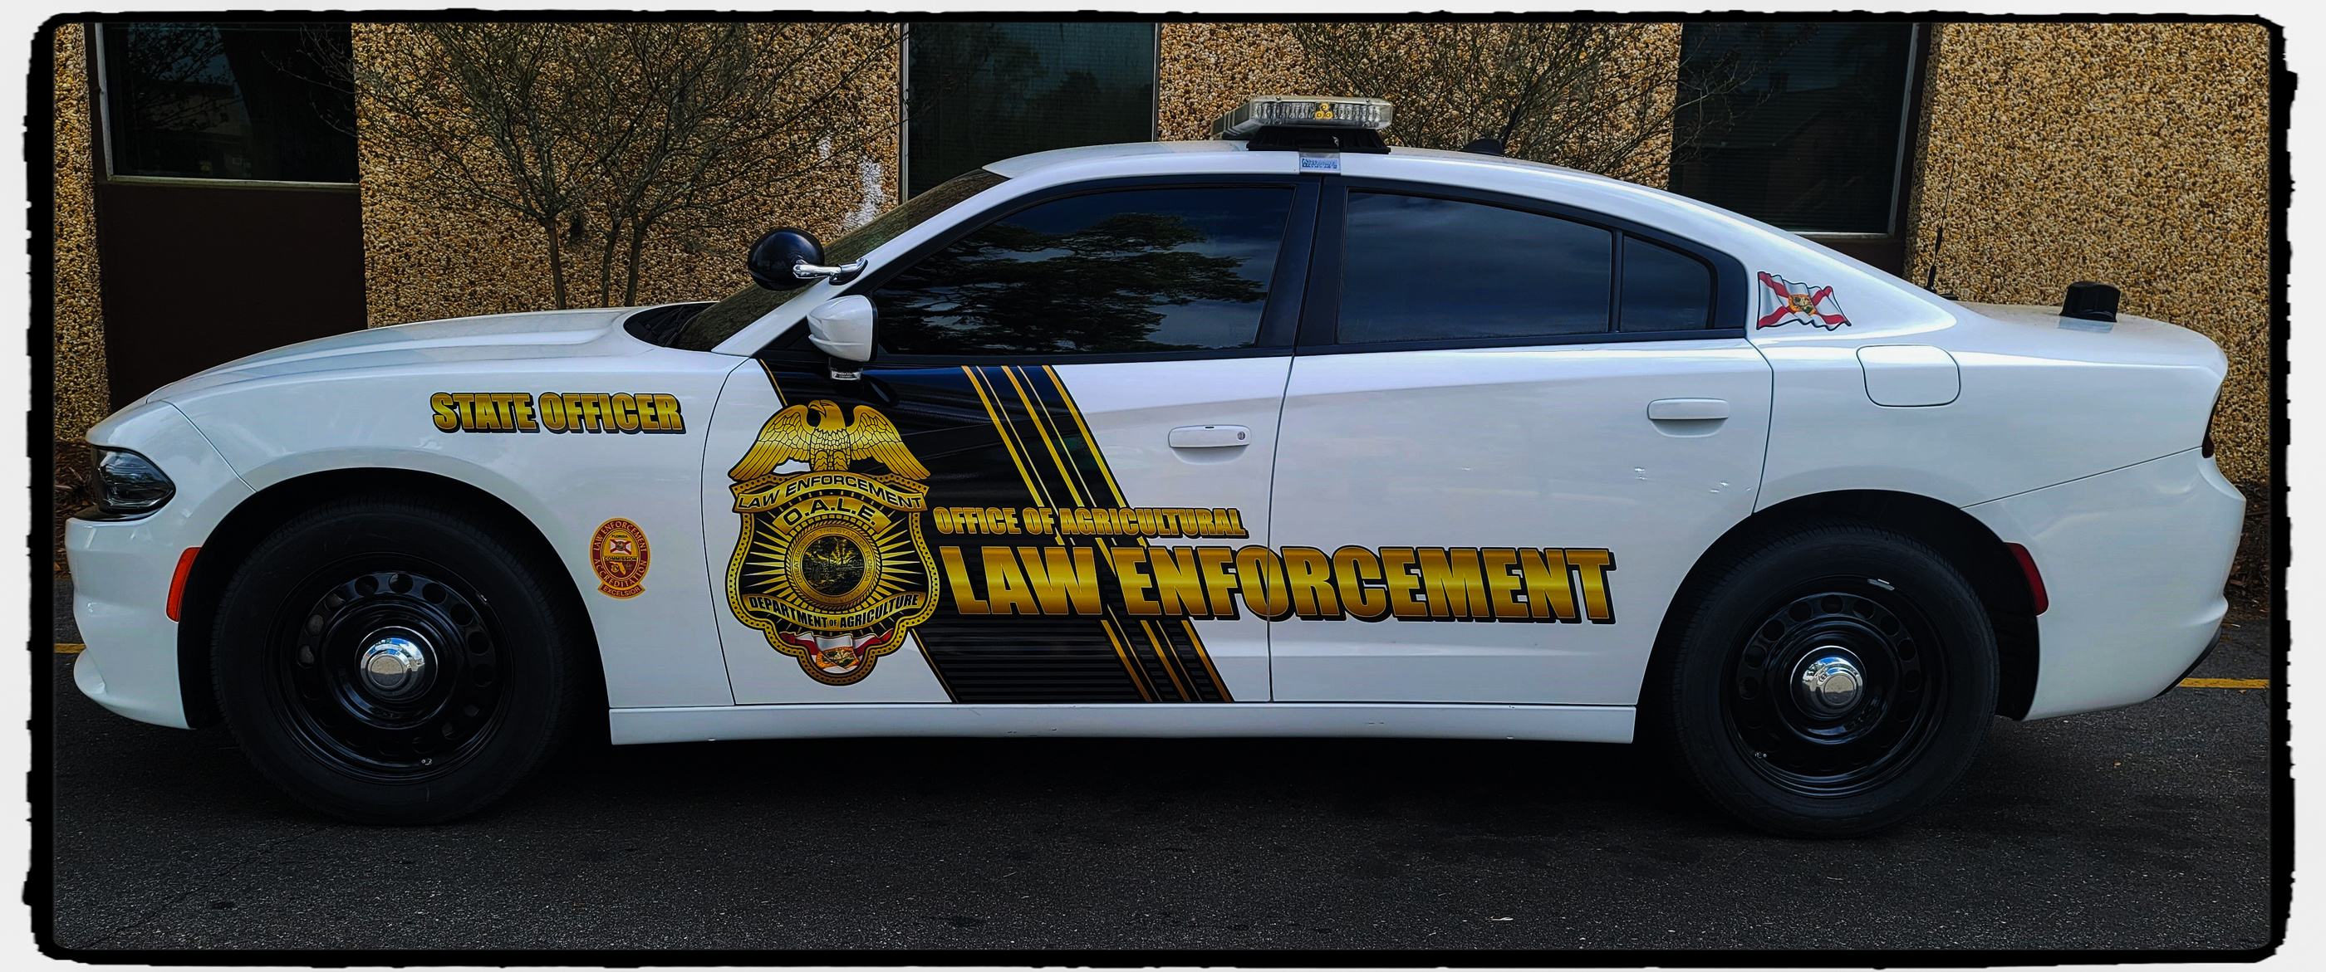
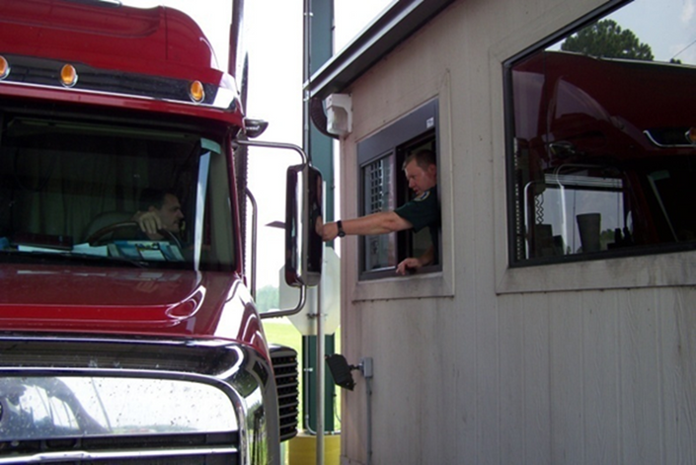
Bureau of Uniform Services
Inspection Stations
OALE Officers conduct inspections 24/7 of agricultural, horticultural, and aquacultural products to ensure the safety of our food supply.

Slide 5
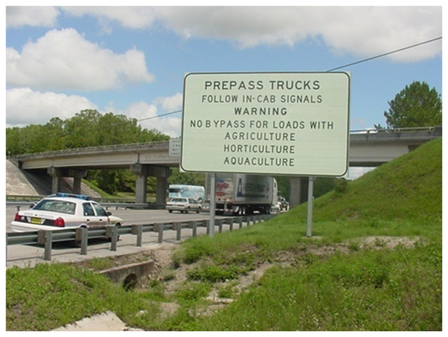
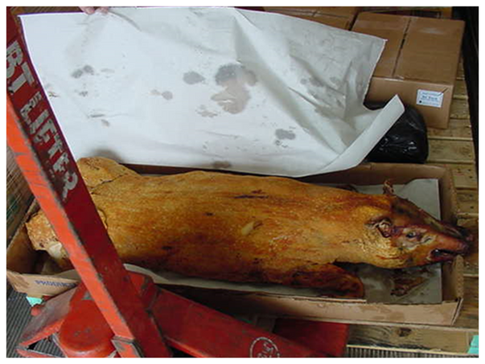
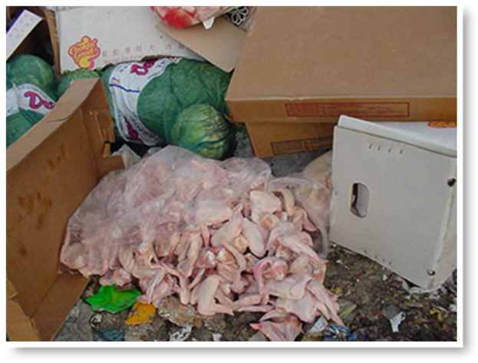
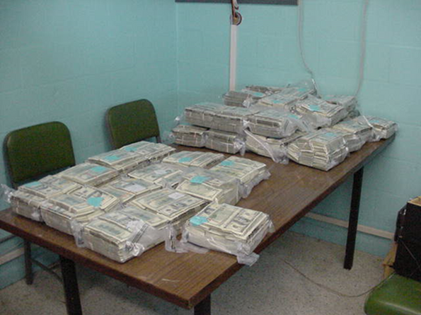
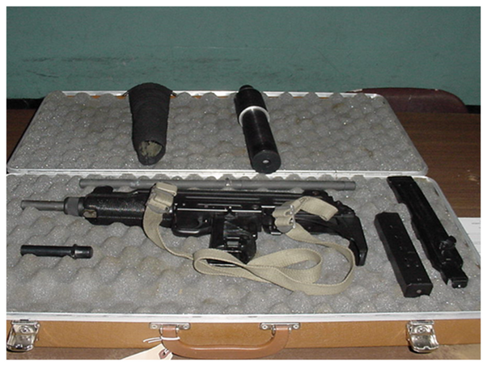
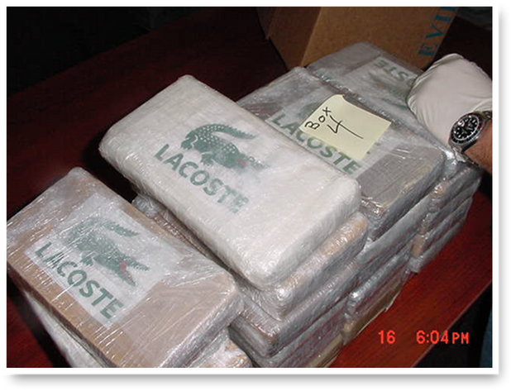
Inspection Station Violations

Slide 6
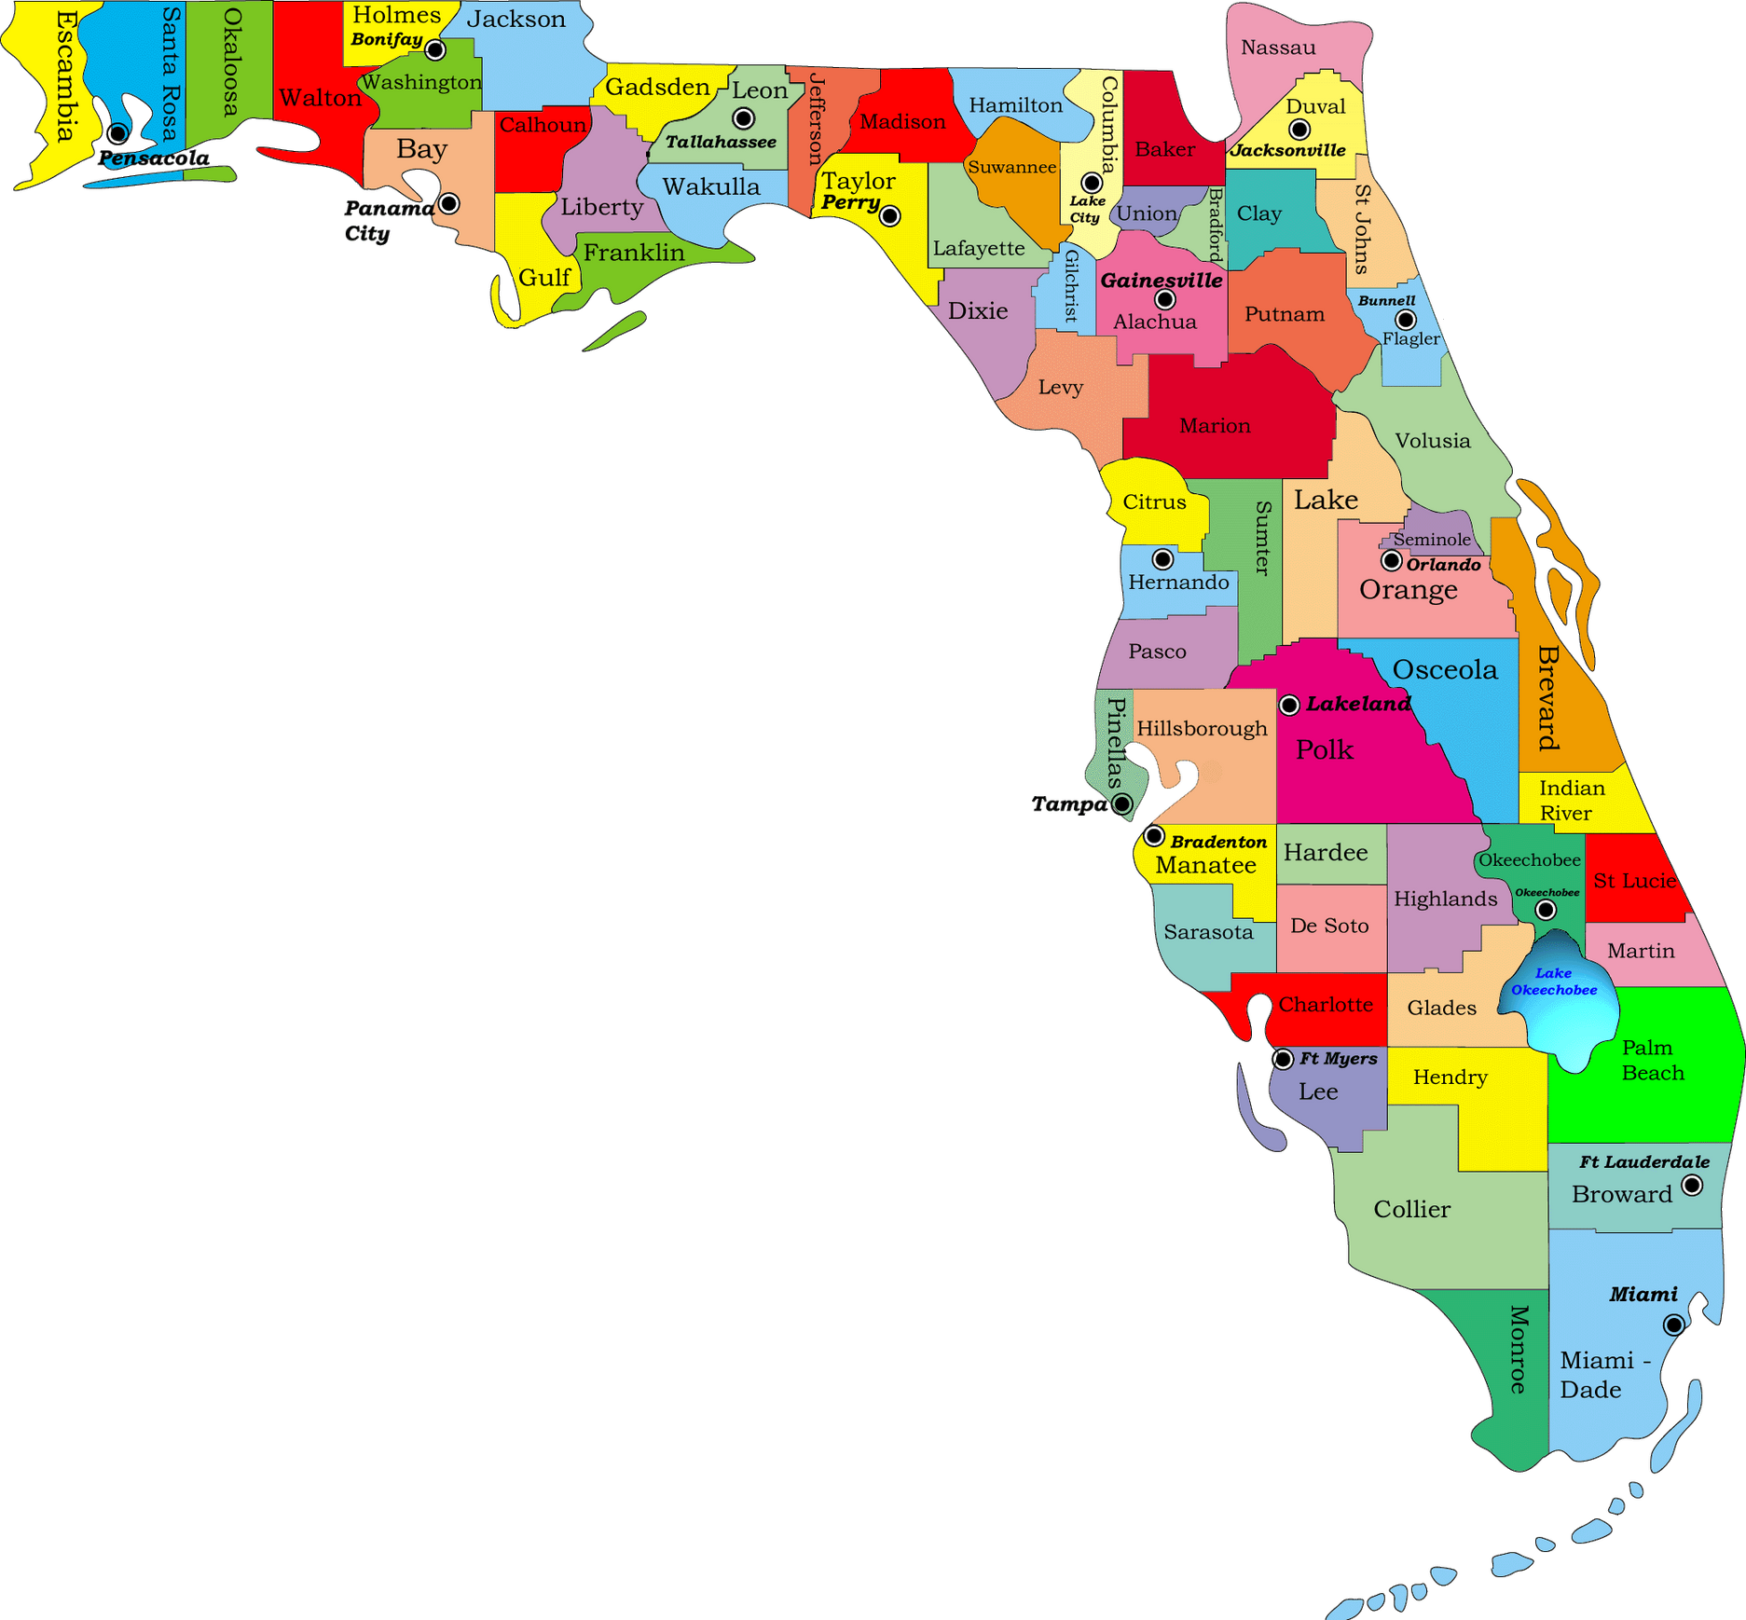
Protected Ag Areas
Florida’s protected agricultural area consists of all counties south of the Suwannee and St. Mary’s Rivers.

Slide 7
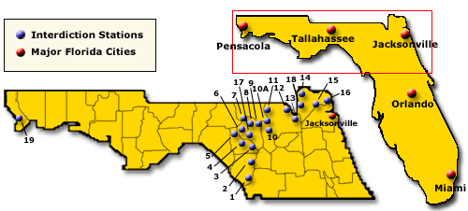
The Bureau of Uniform Services currently has four operational regions and 23 inspection stations located in North Florida and the Panhandle.
The stations are located on every paved highway crossing the natural boundary of the Suwannee and St. Mary’s Rivers.

Slide 8
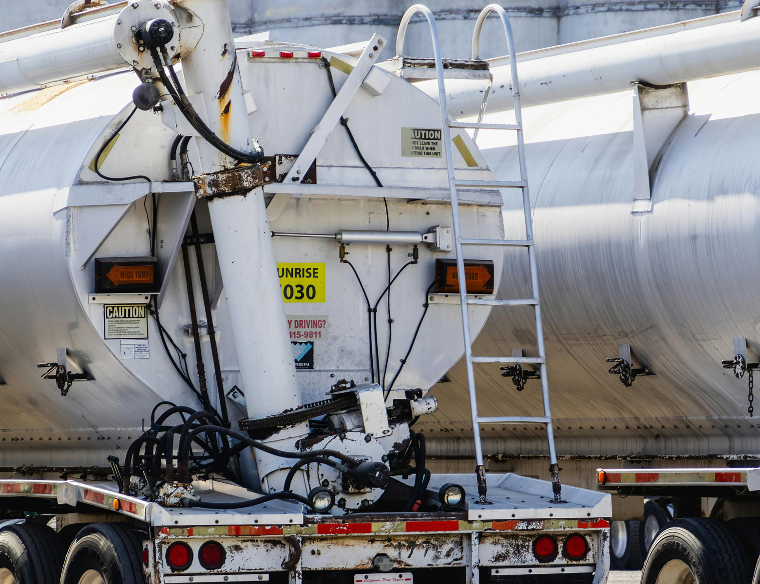
Bureau of Investigative Services
Types of Consumer Complaints and Cases Investigated
Fuel Theft
Wildfires
Construction Fraud
Vacation/Travel Scams
Consumer Services Fraud
Fair Rides Inspection
Price Gauging
Trafficking
White Collar Crime
Motor Vehicle Repair Fraud
Charitable Solicitations
Aquacultural Violations
Timber Theft
Business Fraud
Pawnbroking
Telemarketing

Slide 9
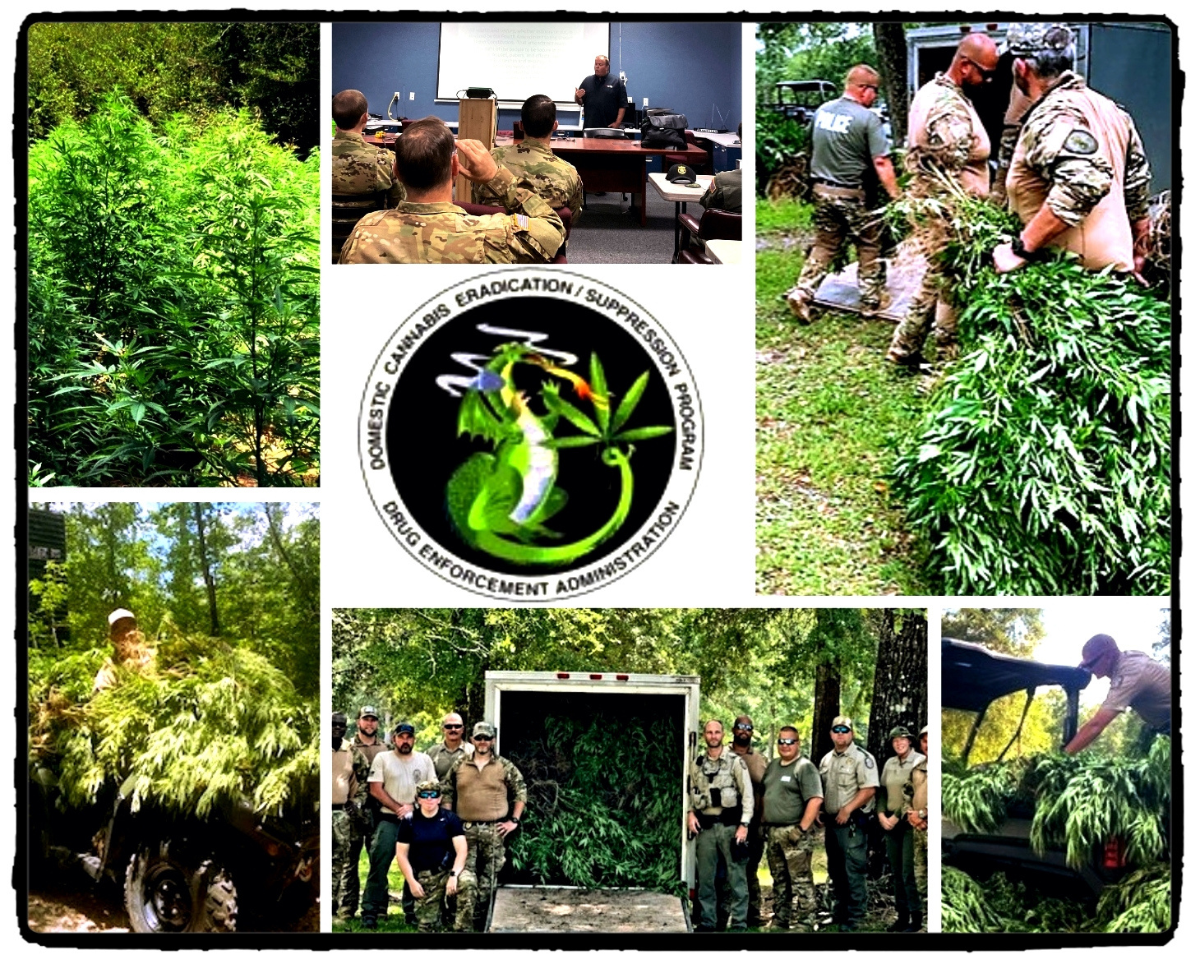

Domestic Marijuana Eradication (DME)

Slide 10
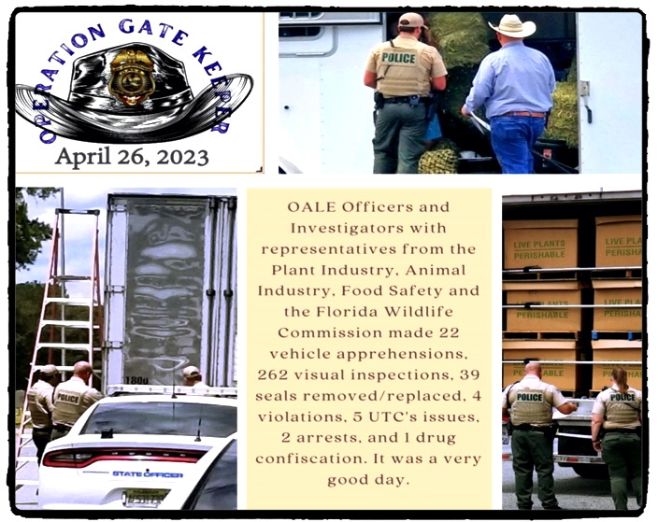
Interagency
Operations
OPERATION GATE KEEPER
In 2023, OALE Officers and Investigators with representatives from the Division of Plant Industry, Animal Industry, Food Safety and the Florida Wildlife Commission made 22 vehicle apprehension 262 visual inspections, 39 seals removed/replaced, 4 violations, 5 UTV’s issued, 2 arrests, and 1 drug confiscation.

Slide 11
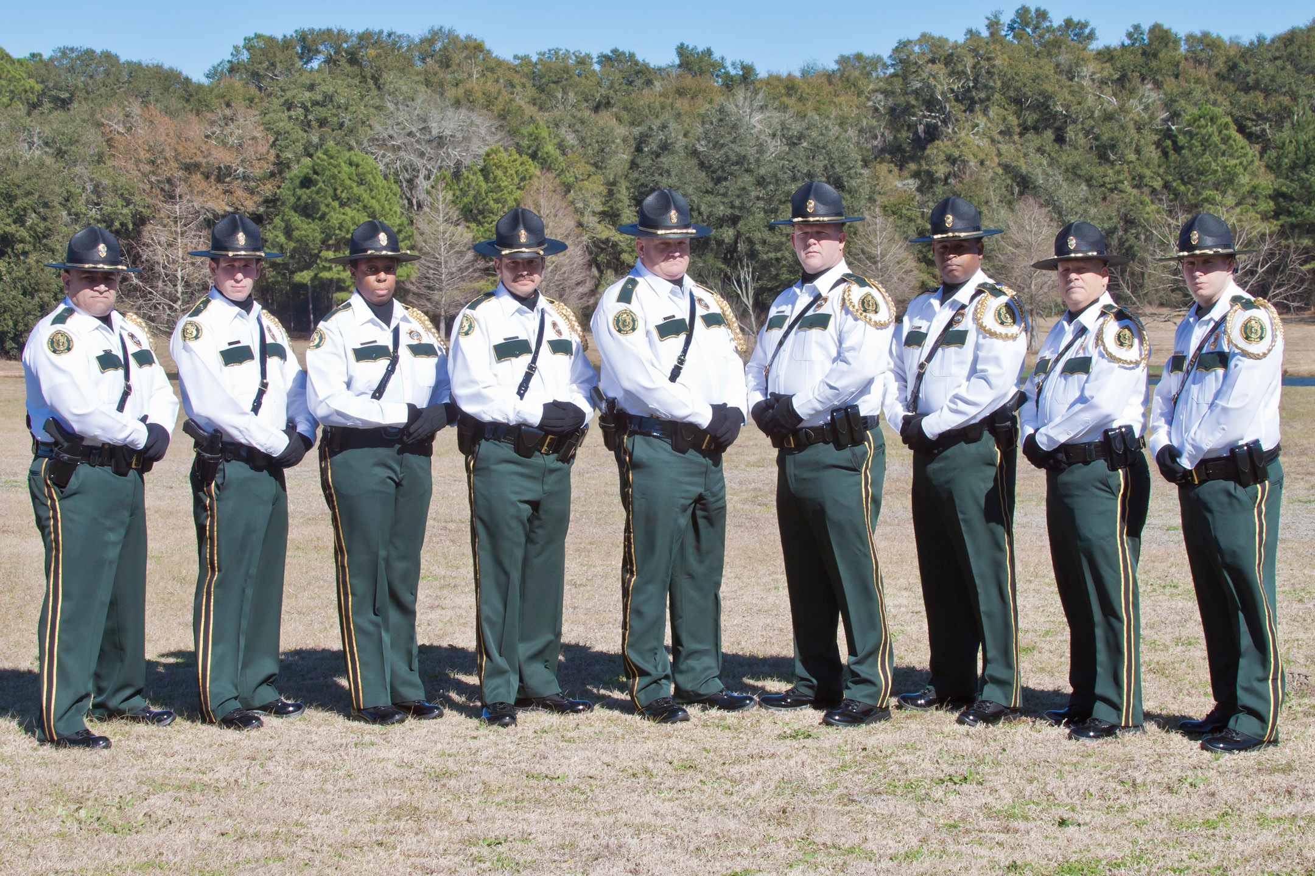
Honor Guard

Slide 12
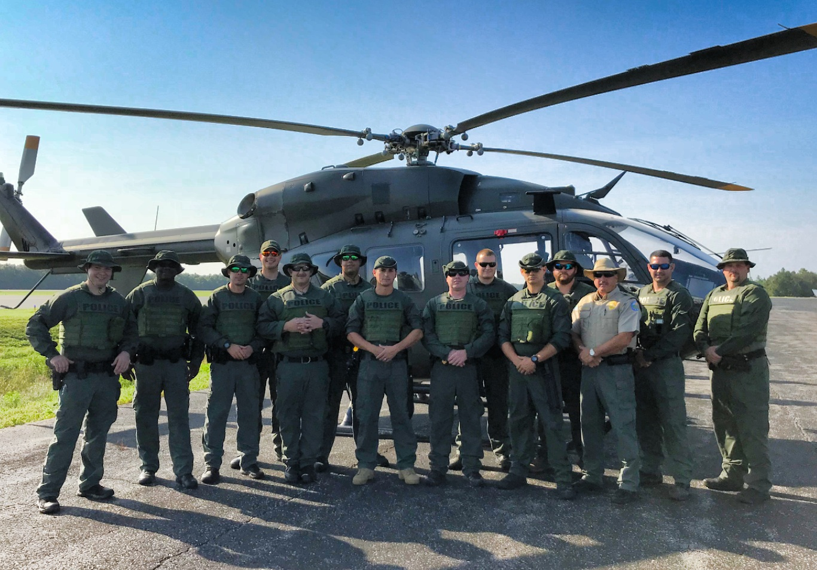
RECON Team

Slide 13
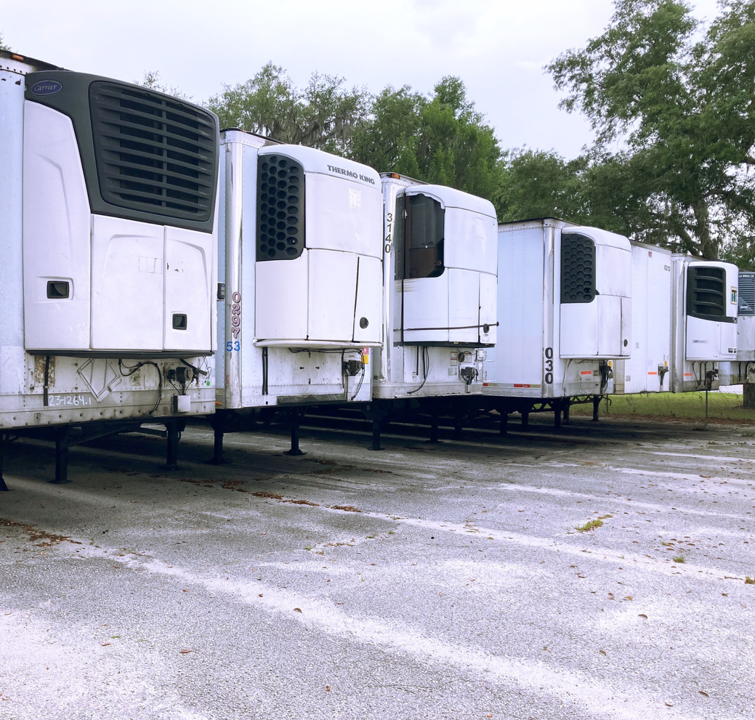
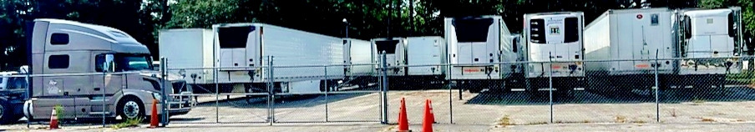
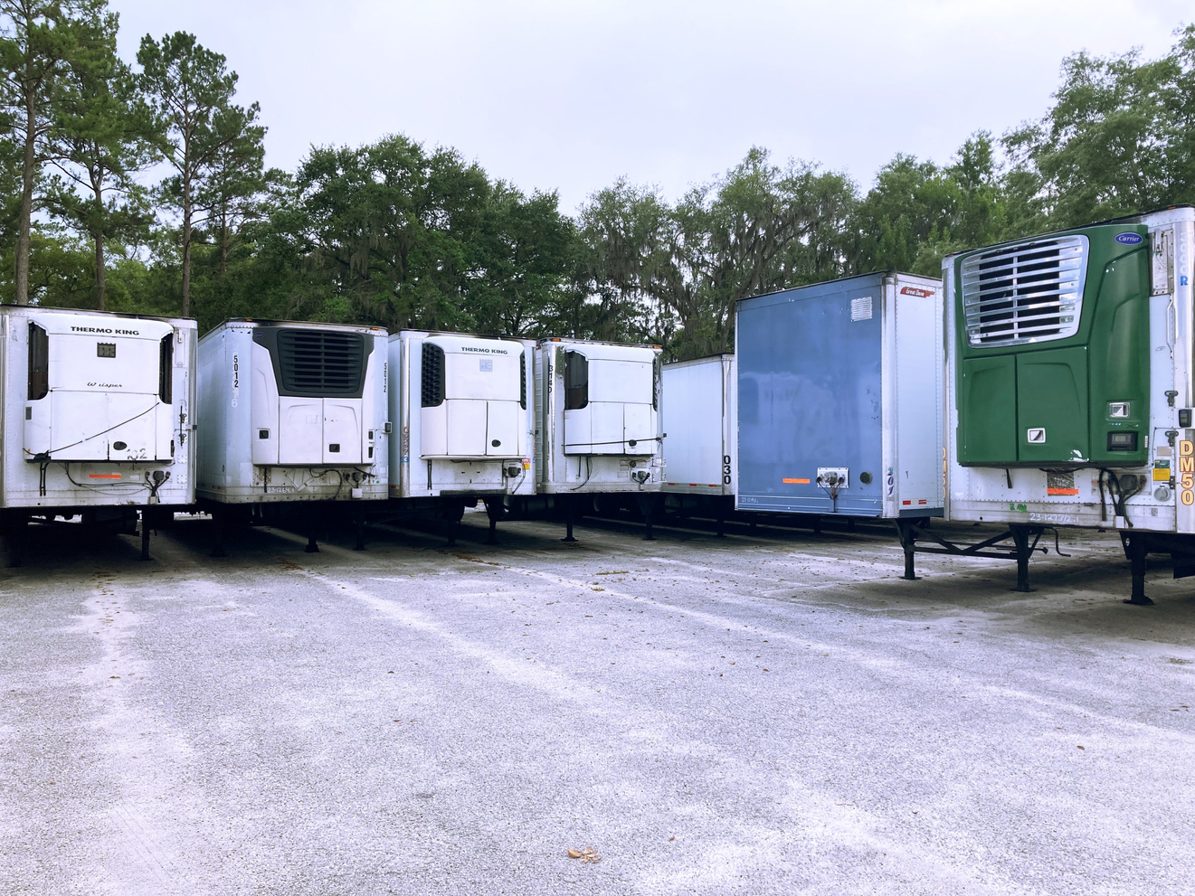
Got trailers?
-Over 368 total trailers recovered, valued at 12,371.500.
-14 Semi Tractors, estimated value at 1,259,000.00.
05

Slide 14
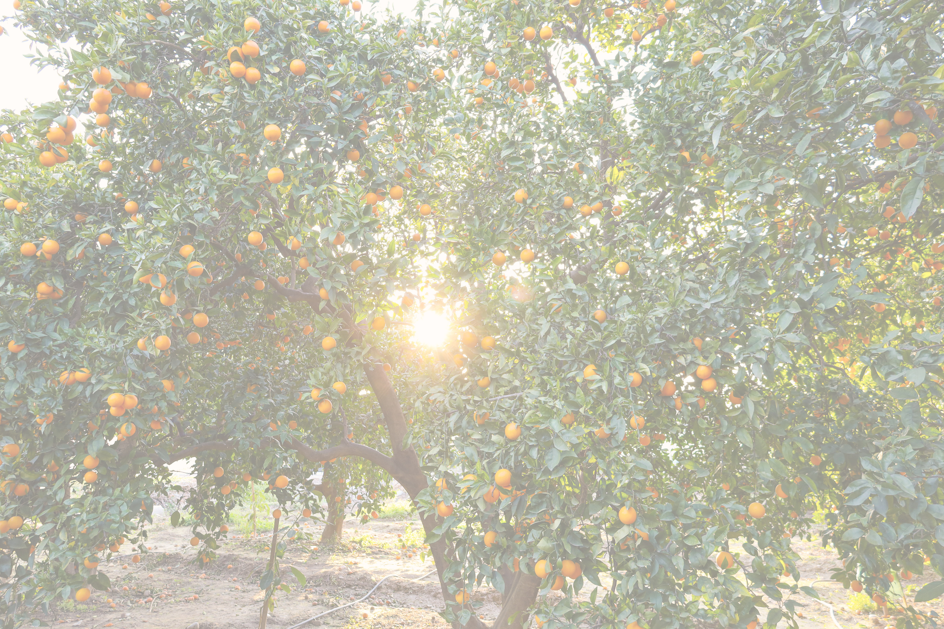
Upcoming
Legislative Changes
Immigration and Inspection Expansion
Station Upgrades and Vehicle Replacement
New Specialty Sworn Positions
Addition of K9 positions to increase detection and protection at interdiction stations.
Reinstatement of CARL positions to increase protection of state forests and assist FFS with investigations.
Additional administrative positions to increase efficiency in recruitment and hiring timeframes and provide crucial support.
New 231 Station Construction expands OALE patrol area in the West part of the State.
Increase in sworn law enforcement positions to increase coverage in and around the new station area.
Addition of LPRs and temporary inspection pads at border and remote locations.
Funding to complete pivotal repairs and upgrades such upgraded station lighting for safety and HVAC system for training facility.
Funding to replace vehicles and provide additional vehicles to sworn personnel.

Slide 15
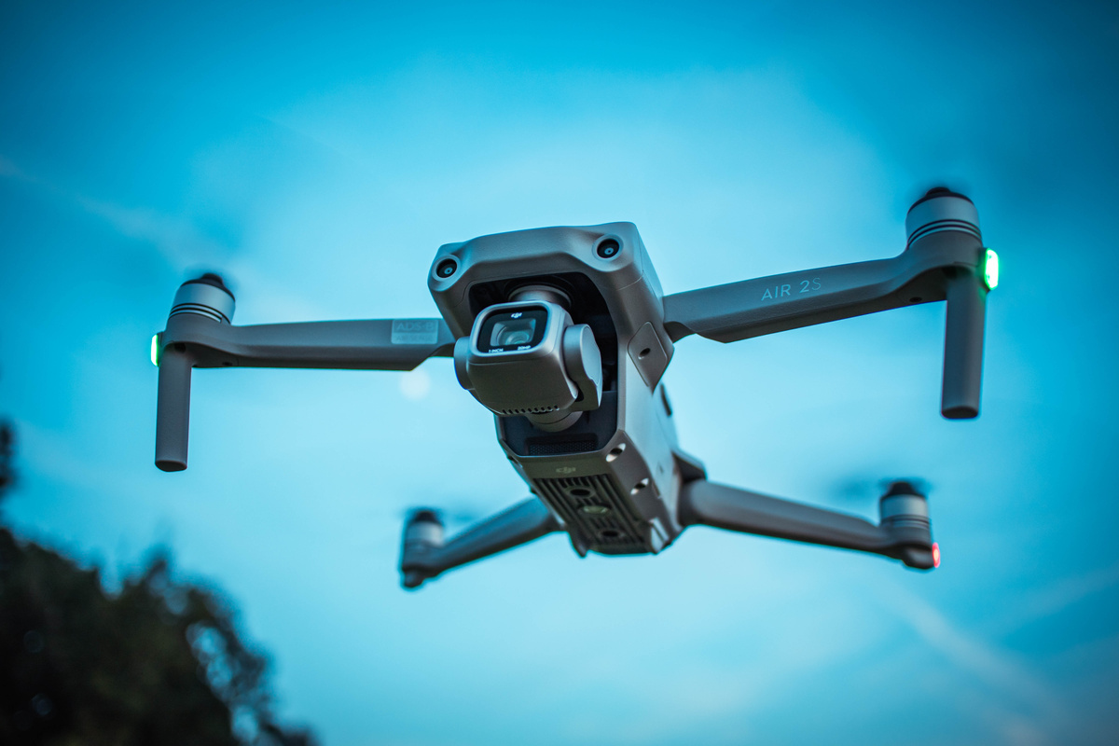
2022 issuance of National Security Memorandum 16 (NSM- 16)
Strengthening the Security and Resilience of United States Food and Agriculture
Critical infrastructure dependencies exist between the Food and Agriculture Sector and the following:
Chemical
Includes fertilizers, pesticides used in the production of crops, as well as common commercial and household chemicals.
Lethal weaponization of drones.
Drone-based sprayers for corrosive attacks which may use a modified remote-activated sprinkler.
Chinese manufactured drones used for critical infrastructure support present operational risks and potentially expose sensitive information, which could jeopardize U.S. national security, as well as public health and safety.

Slide 16
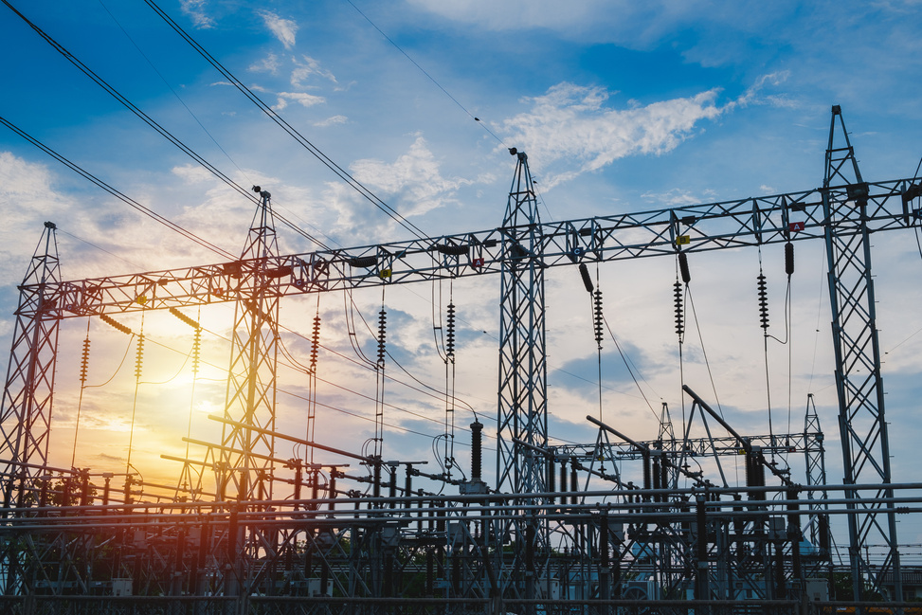
2022 issuance of National Security Memorandum 16 (NSM- 16)
Strengthening the Security and Resilience of United States Food and Agriculture
Critical infrastructure dependencies exist between the Food and Agriculture Sector and the following:
Energy
Powers equipment needed for agricultural production and food processing, as well as the systems by which workers power their lives.
Recent threats by REMVEs who subscribe to an ideology known as Accelerationism, have expressed an interest in attacking various elements of the energy sector.
In addition to this threat group, multiple criminal groups, and individuals see the energy sector and its provision of fuels to the public as a prime avenue by which to create public panic and chaos.

Slide 17
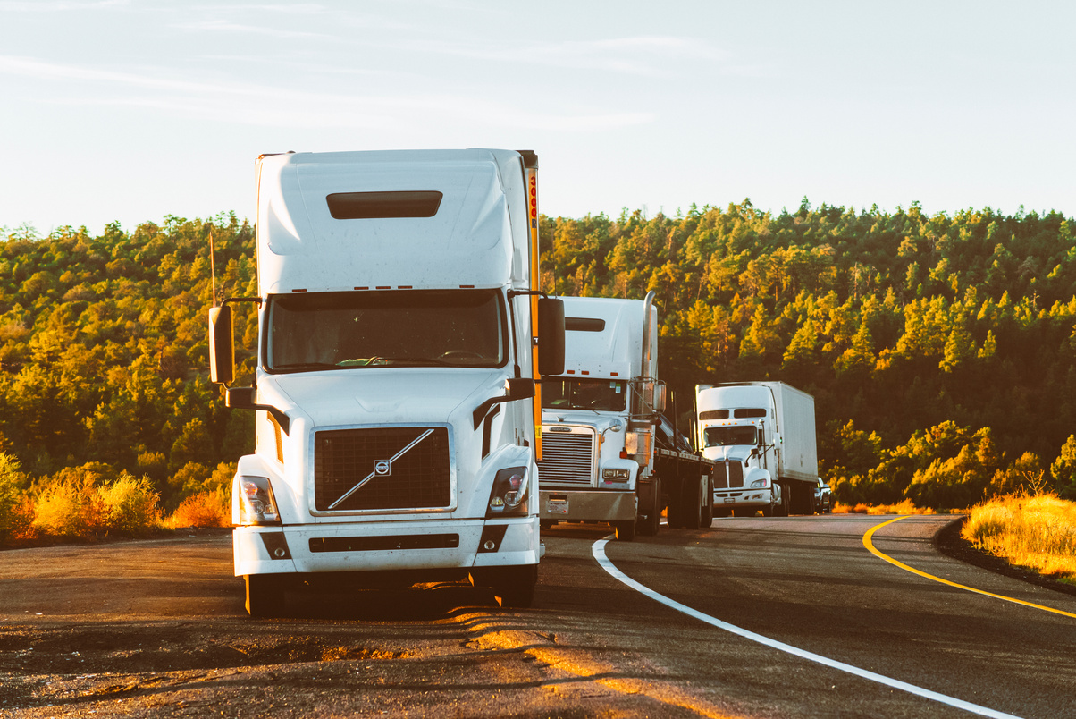
2022 issuance of National Security Memorandum 16 (NSM- 16)
Strengthening the Security and Resilience of United States Food and Agriculture
Critical infrastructure dependencies exist between the Food and Agriculture Sector and the following:
Transportation
Used for movement of products and livestock within the food and agriculture sector.
Recent threats to the transportation sector have included impacts to hazardous commodity transportation, physical threats to infrastructure such as freight rail track sabotage, derailment, damage to crossings and associated support resources.
Non-kinetic threats to the U.S. Highway System include an ever-evolving risk landscape, such as: cyber intrusions of operational systems.
As seen during the Ever Given ship blockage of the Suez Canal in March 2021, world trade and associated transportation corridors are vulnerable to disruption.

Slide 18
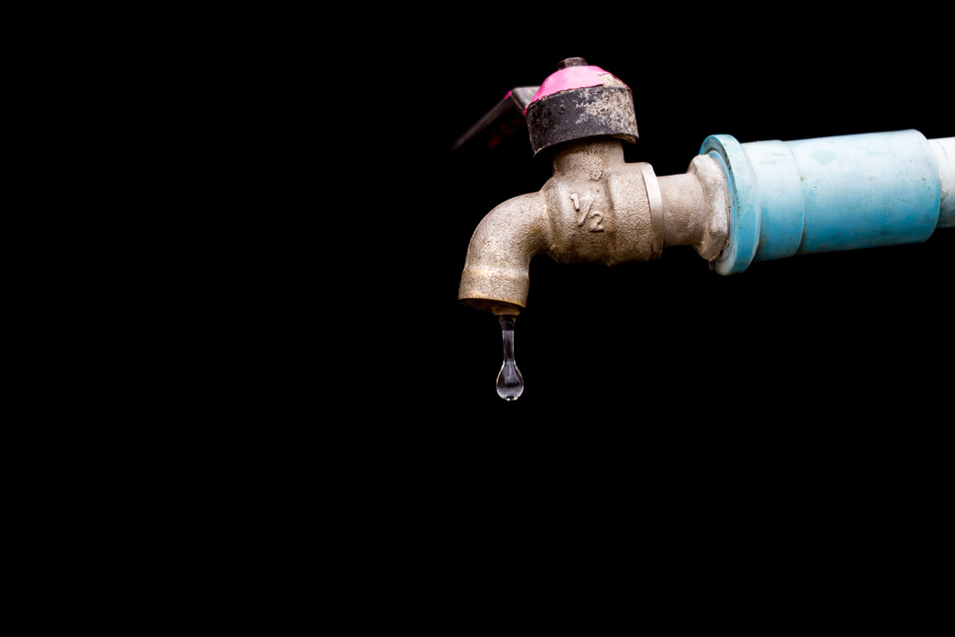
2022 issuance of National Security Memorandum 16 (NSM- 16)
Strengthening the Security and Resilience of United States Food and Agriculture
Critical infrastructure dependencies exist between the Food and Agriculture Sector and the following:
Water and Wastewater Systems
Used to ensure clean water for drinking and irrigation.
Traditional threats to the efficient functionality of water and waste water systems such as drought, and inland flooding.
Malicious persons may conduct cyber attacks to manipulate devices and cause storage tank spills, to conduct ransomware attacks to adversely impact processes, to exploit IT networks in areas where there are geopolitical tensions or conflict. As well as to impact water treatment steps, distribution, water pumps, or control operations.

Slide 19
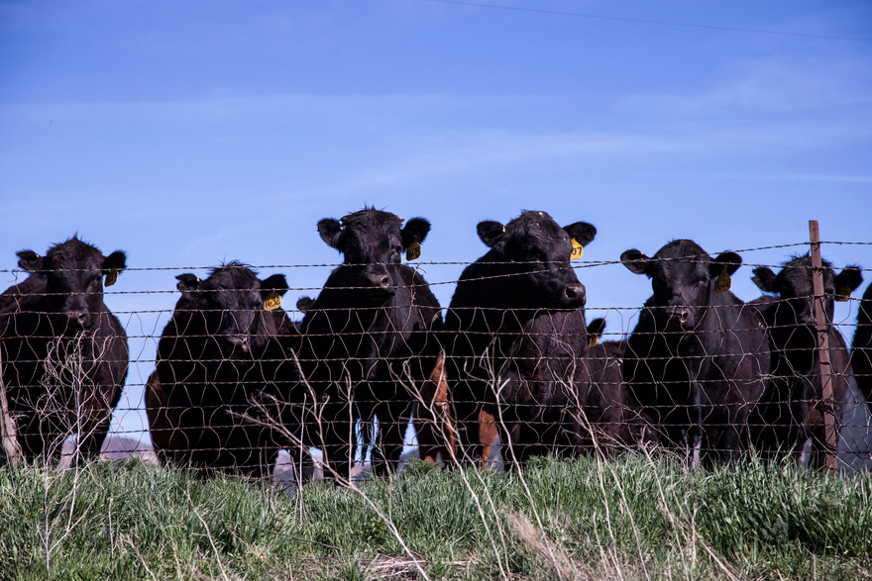
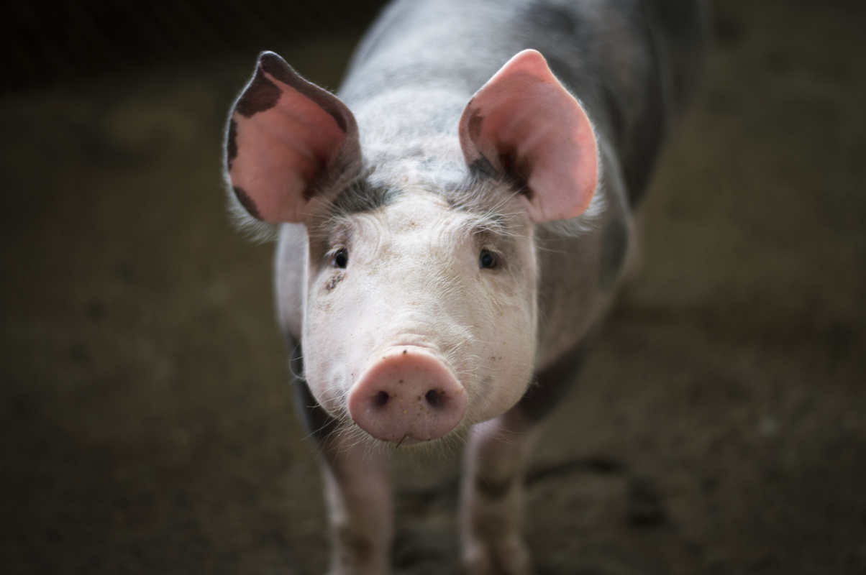
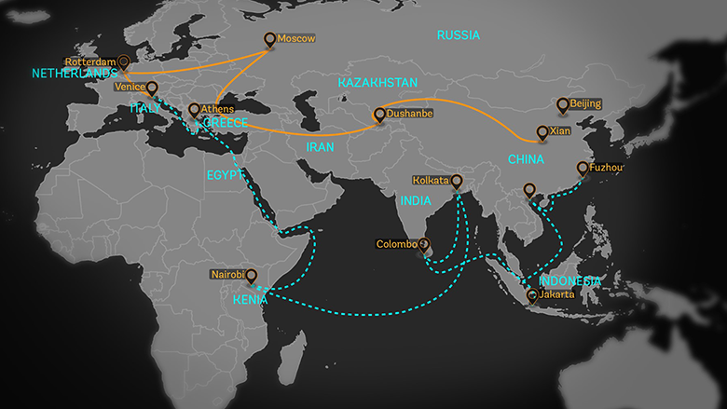
Investment and acquisition of agricultural land and U.S. companies: WH Group acquired Smithfield Foods in 2013. As the largest U.S. pork producer, the Hong Kong based company now has access to all technology, and data, as well as U.S. investments via an IPO which allegedly raised over $500 million in January 2025 when it was released on the Nasdaq Global Select Market.
In 2021, the Russia-linked cyber group Revil hacked JBS, the world’s largest beef producer, with a demand for $11 million. This ransomware attack caused the temporary closure of 9 plants, which directly impacted the U.S., Canada, and Australia. JBS is a Brazilian multi-national company.
According to open source news, China is seeking stronger partnerships with Brazil to support their ambitious infrastructure plan titled the “Belt and Road Initiative” (BRI). The BRI is a multi-pronged plan that reimagines global supply chains, technological connectivity, and military strategy in the run-up to the PRC’s 100-year anniversary in 2049.
System Wide Vulnerabilities

Slide 20
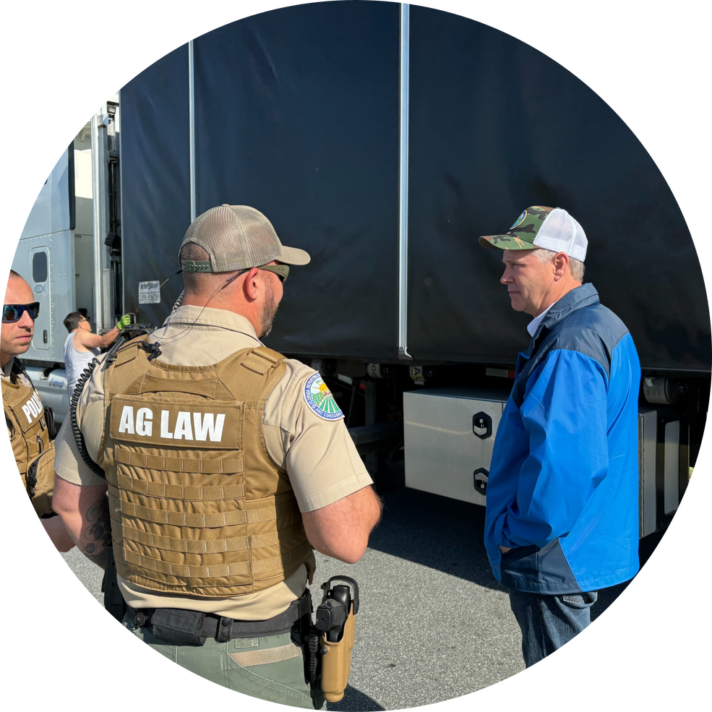

Need OALE?
Our main phone line is manned 24/7 either through Headquarters or inspection stations and you will be directed to the appropriate bureau.
1-800-342-5869

Slide 21
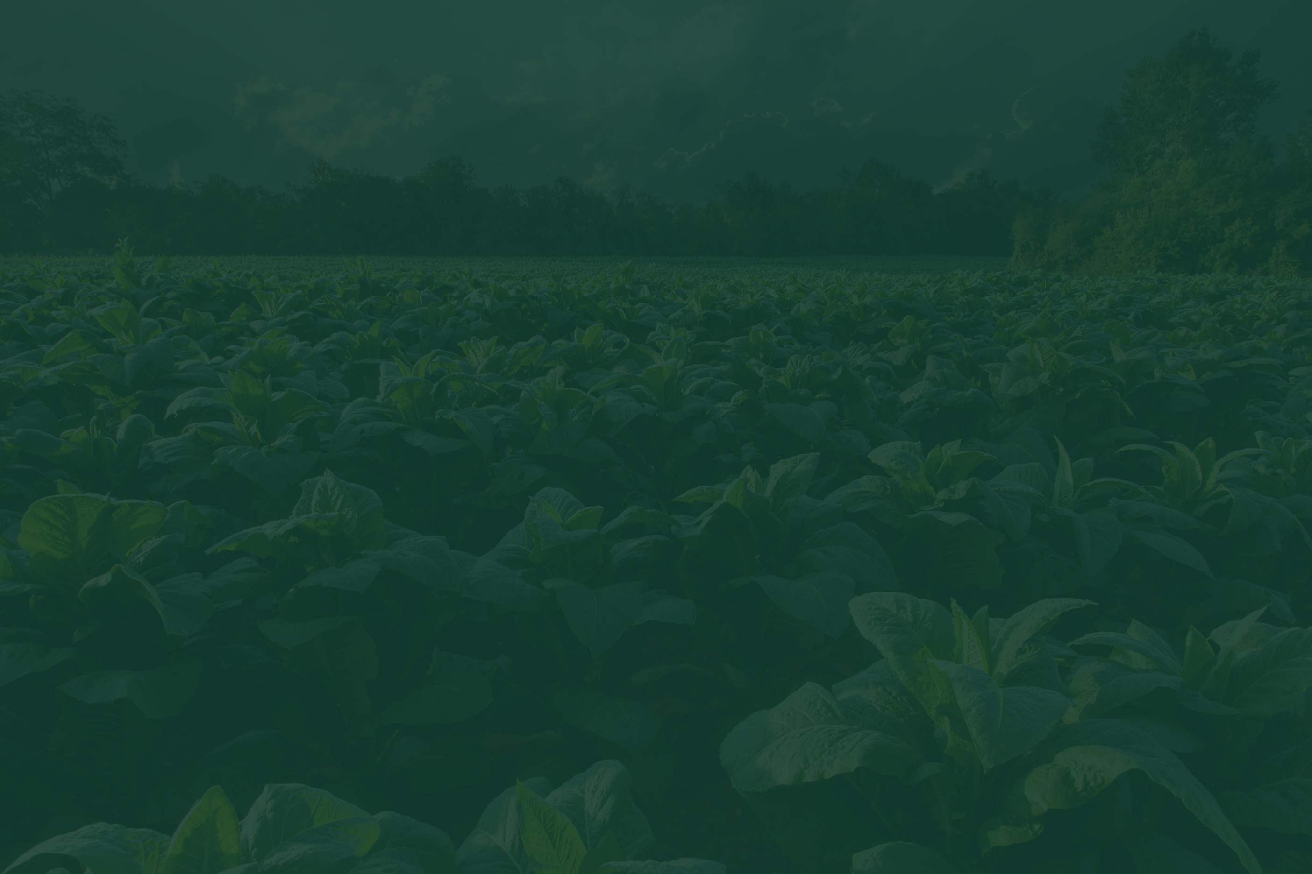
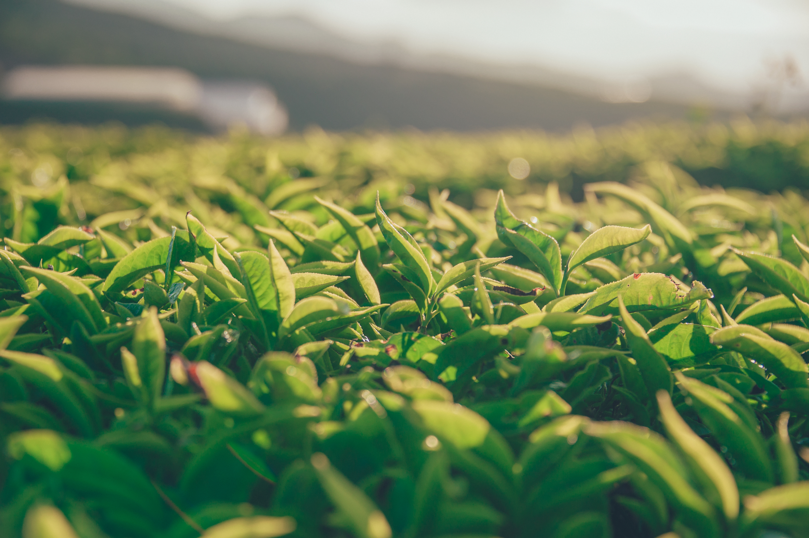
Questions?
Colonel Lee Adams
Agricultural Law Enforcement Director
Florida Department of Agriculture and Consumer Services
Office of Agricultural Law Enforcement
The Terry L. Rhodes Building, Ste. B
2005 Apalachee Pkwy.
Tallahassee, FL 32399-6500

